Slide 1
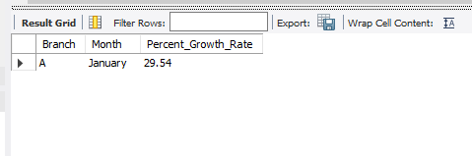
Task 1 : Identifying the Top Branch by Sales Growth Rate (6 Marks) Walmart wants to identify which branch has exhibited the highest sales growth over time. Analyze the total sales for each branch and compare the growth rate across months to find the top performer.
SQL QUERY
WITH Monthly_Sales AS ( SELECT Branch, MONTHNAME(Date) AS Month, SUM(Total) AS Sales FROM walmartsales
GROUP BY Branch, Month),
Growth_Calculator AS ( SELECT Branch, Month, Sales, LAG(Sales) OVER (PARTITION BY Branch ORDER BY Month)
AS Prev_Sales FROM Monthly_Sales)
SELECT Branch,Month, ROUND(((Sales - Prev_Sales) / Prev_Sales) * 100, 2) AS Percent_Growth_Rate
FROM Growth_Calculator WHERE Prev_Sales IS NOT NULL
GROUP BY Branch,Month
ORDER BY Percent_Growth_Rate DESC LIMIT 1;
OUTPUT

Slide 2
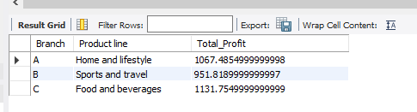
Task 2 : Finding the Most Profitable Product Line for Each Branch (6 Marks) Walmart needs to determine which product line contributes the highest profit to each branch. The profit margin should be calculated based on the difference between the gross income and cost of goods sold started with getting a table where I grouped each bracnh and respective productline to get total profit from each branch
SQL QUERY
WITH Profits AS ( SELECT Branch, `Product line`, SUM(`gross income`) AS Total_Profit FROM walmartsales GROUP BY Branch, `Product line`),
Profit_Ranking AS ( SELECT *, RANK() OVER (PARTITION BY Branch ORDER BY Total_Profit DESC) AS profit_rank FROM Profits)
SELECT Branch,`Product line`,Total_ProfitFROM Profit_RankingWHERE profit_rank = 1;

Slide 3
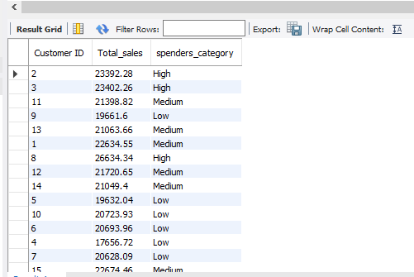
Task 3 : Analyzing Customer Segmentation Based on Spending (6 Marks) Walmart wants to segment customers based on their average spending behavior. Classify customers into three tiers: High, Medium, and Low spenders based on their total purchase amounts.
SQL QUERY
SELECT `CustomerID`, round(sum(Total),2) AS Total_sales,
CASE WHEN round(sum(Total),2) > 23000 THEN 'High’
WHEN round(sum(Total),2) BETWEEN 21000 AND 23000 THEN 'Medium’
ELSE 'Low’
END AS spenders_category
FROM walmartsalesgroup by `Customer ID`;

Slide 4
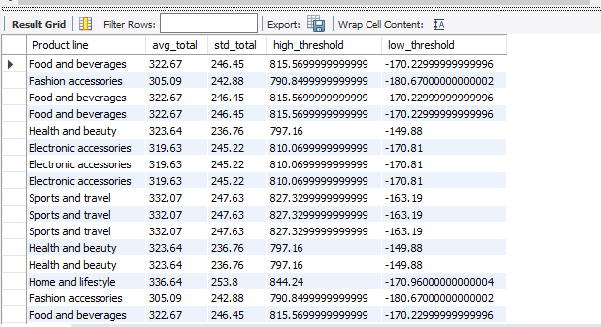
Task 4 : Detecting Anomalies in Sales Transactions (6 Marrks) Walmart suspects that some transactions have unusually high or low sales compared to the average for the product line. Identify these anomalies.
SQL QUERY
WITH productdata AS
(SELECT `Product line`,
round(AVG(Total),2) AS avg_total,
round(stddev(Total),2) AS std_total
FROM walmartsalesGROUP BY `Product line`),
annomalities AS
(SELECT w.`Product line`, pd.avg_total,pd.std_total
FROM productdata pd JOIN walmartsales w ON w.`Product line` = pd.`Product line`
WHERE w.Total > pd.avg_total + 2 * pd.std_total OR w.total < pd.avg_total - 2 * pd.std_total)
SELECT * , avg_total + 2 * std_total AS high_threshold ,
avg_total - 2 * std_total AS low_threshold FROM annomalities;

Slide 5
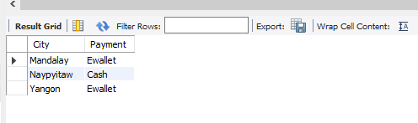
Task 5 : Most Popular Payment Method by City (6 Marks) Walmart needs to determine the most popular payment method in each city to tailor marketing strategies.
SQL QUERY
SELECT City, Payment
FROM (SELECT City, Payment, RANK() OVER (PARTITION BY City ORDER BY COUNT(*) DESC) AS payment_rank
FROM walmartsales
GROUP BY City, Payment) popular_payment
WHERE payment_rank = 1;

Slide 6
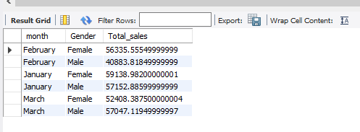
Task 6 : Monthly Sales Distribution by Gender (6 Marks) Walmart wants to understand the sales distribution between male and female customers on a monthly basis.
SQL QUERY
SELECT MONTHNAME(Date) AS month, Gender, SUM(Total) AS Total_sales
FROM walmartsales
GROUP BY month , Gender
ORDER BY month , Gender;

Slide 7
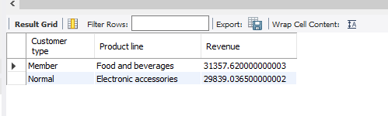
Task 7 : Best Product Line by Customer Type (6 Marks) Walmart wants to know which product lines are preferred by different customer types(Member vs. Normal).
SQL QUERY
WITH Customer_Product AS ( SELECT `Customer type`, `Product line`, SUM(Total) AS Revenue
FROM walmartsales GROUP BY `Customer type`, `Product line`),
Ranked_Product AS ( SELECT *, RANK() OVER (PARTITION BY `Customer type` ORDER BY Revenue DESC) AS ranking FROM Customer_Product)
SELECT `Customer type`, `Product line`, RevenueFROM Ranked_ProductWHERE ranking = 1;

Slide 8
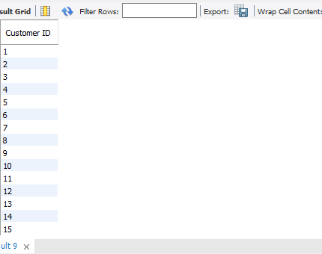
Task 8 : Identifying Repeat Customers (6 Marks) Walmart needs to identify customers who made repeat purchases within a specific time frame (e.g., within 30 Days)
SQL QUERY
SELECT DISTINCT `Customer ID`
FROM ( SELECT `Customer ID`, Date, LAG(Date) OVER (PARTITION BY `Customer ID` ORDER BY Date) AS prev_date
FROM walmartsales) AS sub
WHERE DATEDIFF(Date, prev_date) <= 30;

Slide 9
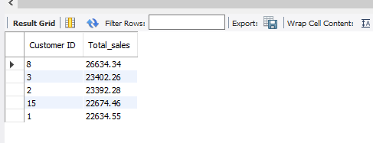
Task 9 : Finding Top 5 Customers by Sales Volume (6 Marks) Walmart wants to reward its top 5 customers who have generated the most sales Revenue.
SQL QUERY
SELECT `Customer ID` , ROUND(SUM(Total), 2) AS Total_sales
FROM walmartsales
GROUP BY `Customer ID`
ORDER BY Total_sales DESC
LIMIT 5;

Slide 10
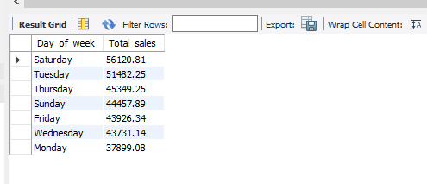
Task 10 : Analyzing Sales Trends by Day of the Week (6 Marks) Walmart wants to analyze the sales patterns to determine which day of the week brings the highest sales
SQL QUERY
SELECT DAYNAME(Date) AS Day_of_week , ROUND(SUM(Total), 2) AS Total_sales
FROM walmartsales
GROUP BY Day_of_week
ORDER BY Total_sales DESC;

Slide 11
Video Link
https://drive.google.com/file/d/1Qi7Acbparx8fs7PYTe1xgL_uY4MLLBTC/view?usp=drive_link

